Slide 1
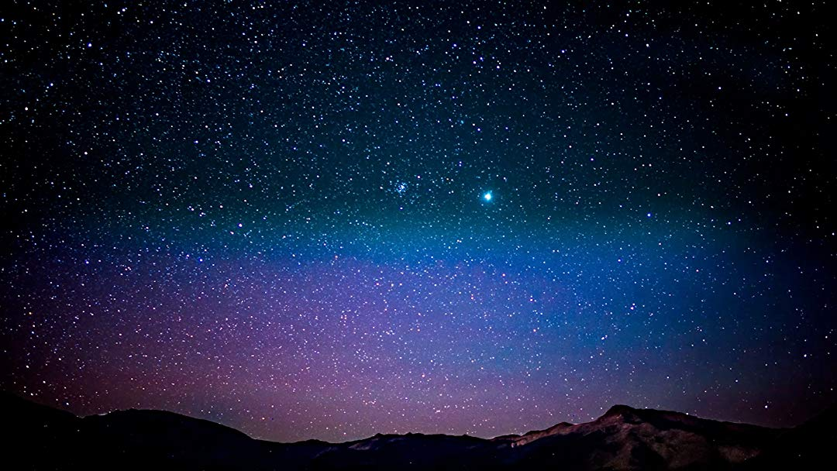
STAR GAZER

Slide 2
AUTHORS
Elizabeth Garcia-Quilinquin
Laurie Schroeder
Jared Bucko
James Nelson

Slide 3
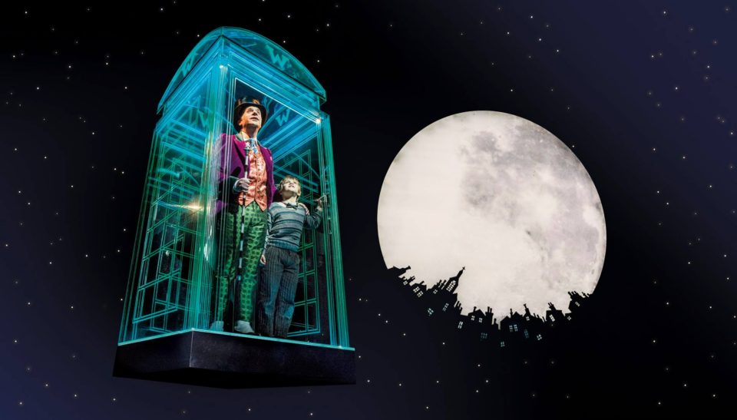

Slide 4

Concept
Astrological app for elementary children.
As a teacher, I want an easy way for my students to learn about the different constellations, without ads.
As a student, having an app that is easy to navigate and displays cool pictures is awesome!

Slide 5
Live demo

Slide 6
Process
To achieve our end goal we utilized a variety of NPM packages, a Mysql database, & used Eslint as our linter with Travis.cli doing the repo validations before committing our pulls to master.
Liz and Jared took on the huge tasks of creating our database and figuring out Sequelize. Laurie designed the frontend along with Jared and Liz’s help. James setup the Github repo and got the linting process to work.
One challenge we had was utilizing the NPM module Sequelize. Jared will explain further.
Our biggest success was finally being able to display the constellation images and information within our web page.

Slide 7
FUTURE DEVELOPMENT
Saving constellations
Location services
More information
Added features
Password retrieval
Search options
Interactive sky map

Slide 8
Links
Deployed
https://limitless-atoll-63723.herokuapp.com/
GitHub repo
https://github.com/alpinelife37/Project-2

Slide 9
Thank you!

